Slide 1
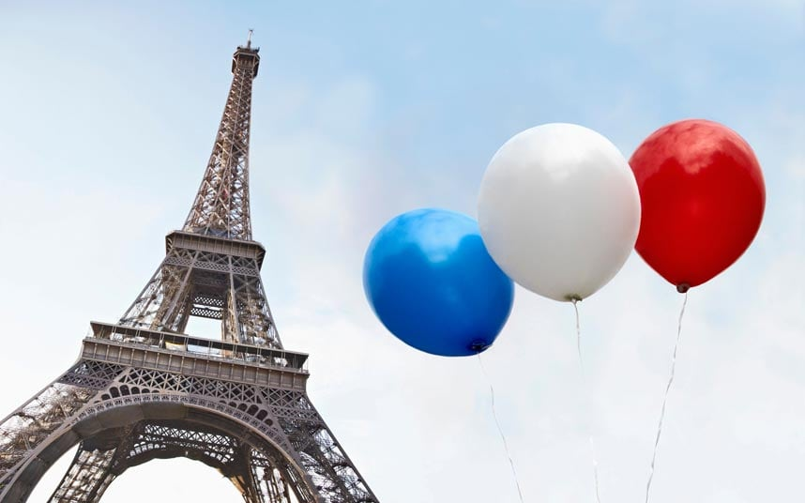
France
Koto, Mina, Madoka

Slide 2
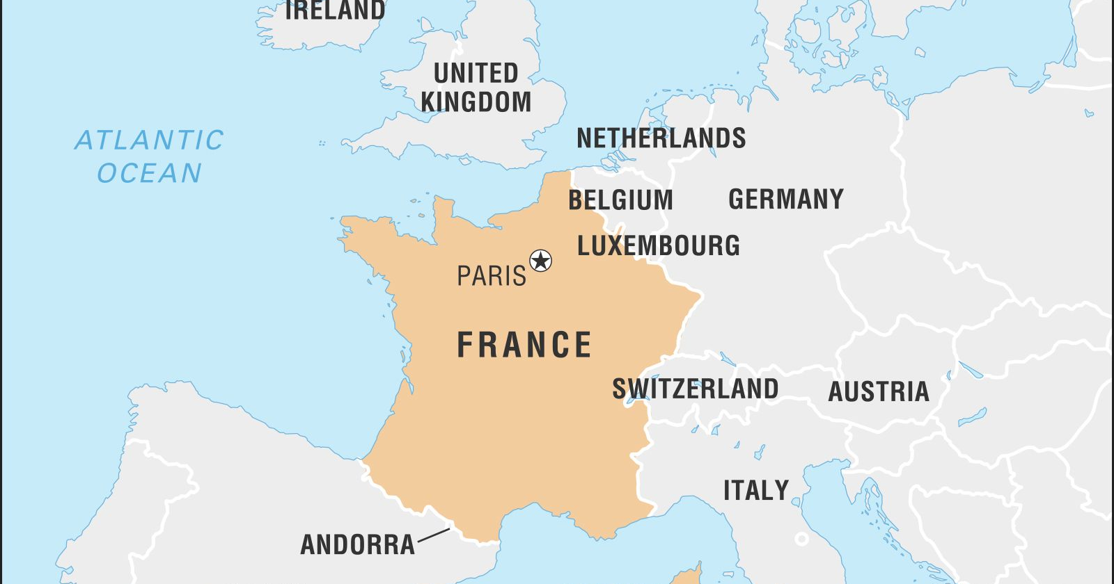
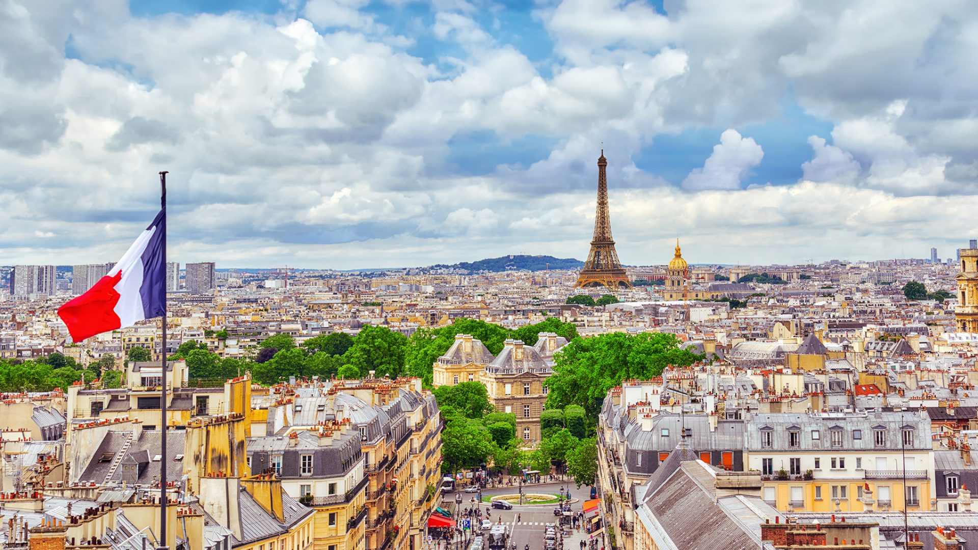
Introduction
Location- Western Europe
Capital city- Paris
Language- French(88%)
Some minority languages
Population- about 6,5270000
Religion- Many types religions
Christianity - Catholic

Slide 3
Economy-1 Money
[Dollar]Canada,USA
・[Euro]Member of the EU

Slide 4
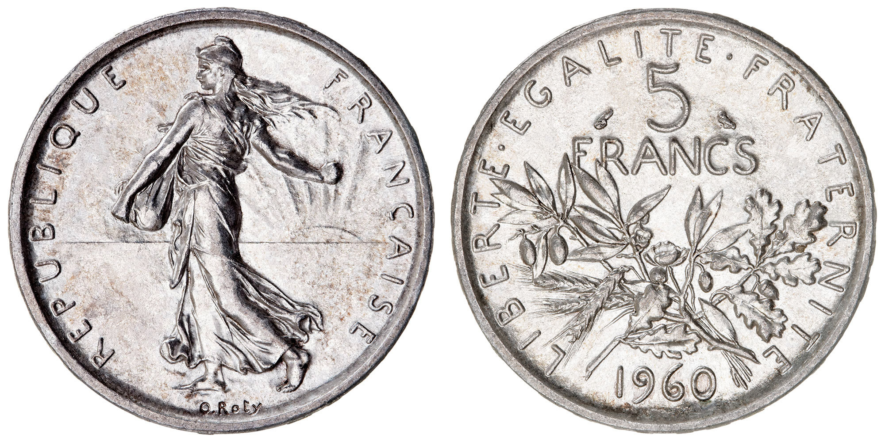
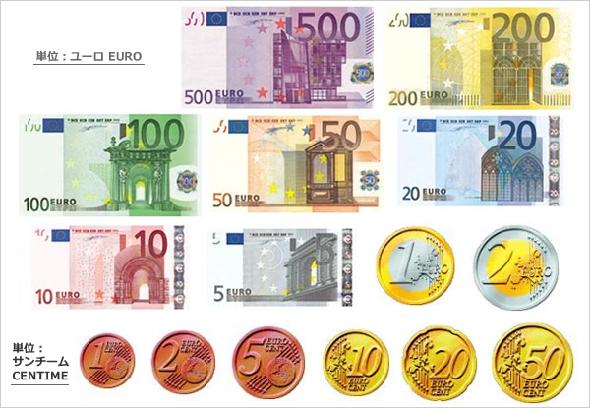
Euro €
1Euro=145 yen (JP), 1.34(CAD). Oct 22nd, 2022
1Euro= 100 centime
Bill: 7 types of Euros.
Coins: 6 types of cents and 1,2,Euros.
・Franc (by 2005)

Slide 5
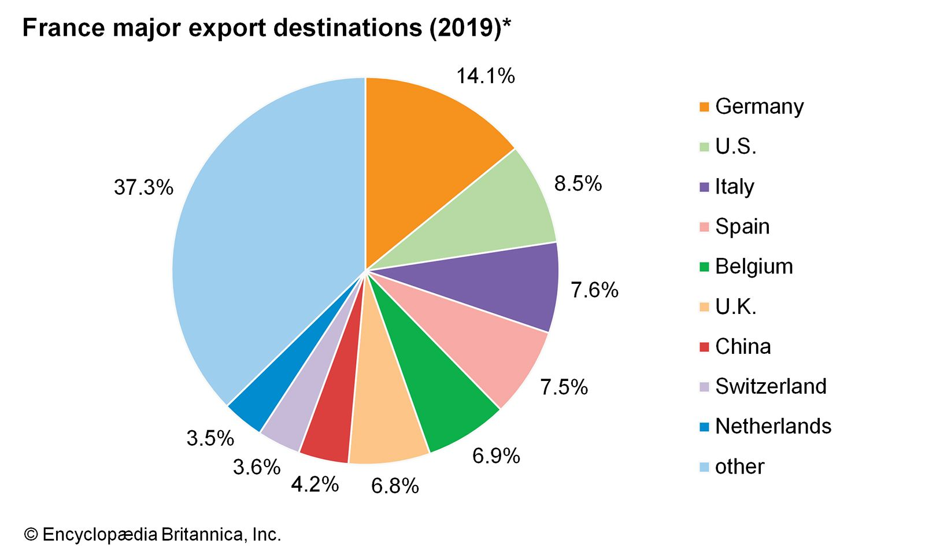
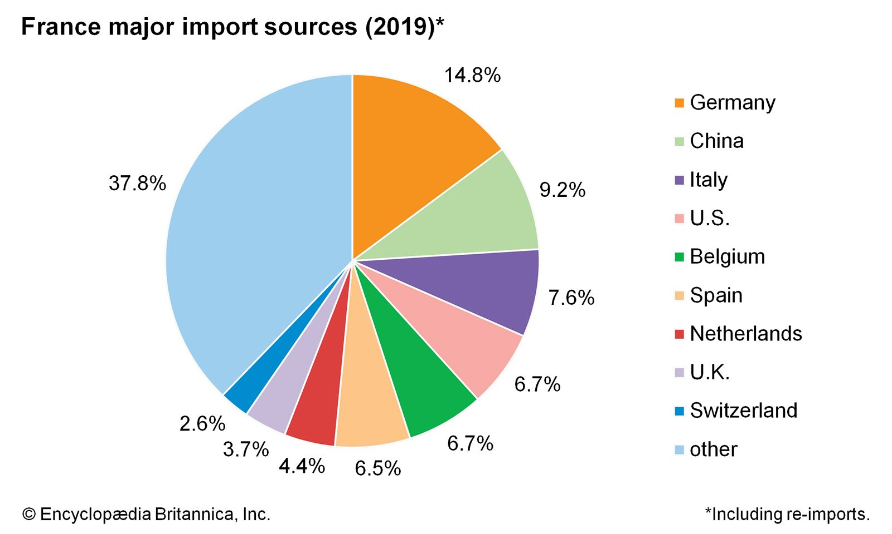
Economy2- Trading
Total trading amount in 2021
Export: 5,009 billion Euro
Import: 5,855 billion Euro
Mainly trading goods
Export: agricultural products, chemicals, cars, industrial products.
Import: cars, computers, electronic machine
←Mainly trading countries

Slide 6
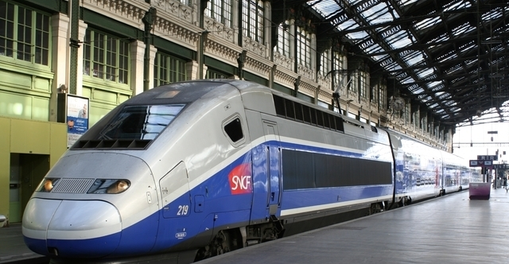
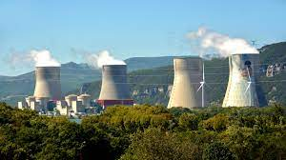
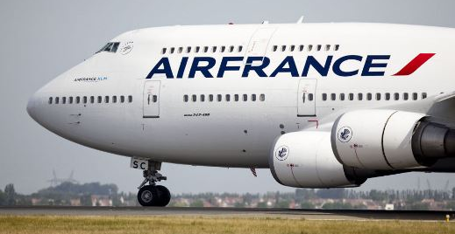
Trading
French Uncertainty Avoidance at 86%.
↓
They can develop complex technologies and systems.

Slide 7
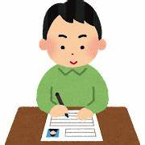
Education
Compulsory education
・Kindergarten
・Elementary school 12 Years
・Middle school
・High school
・University （only registration fee）
School expenses are free!

Slide 8


Kindergarten
4,5 years old
3 years old
Only the time to play
Time of play and the study

Slide 9
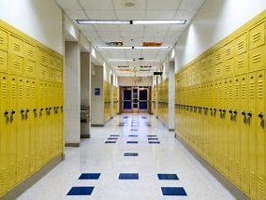
High school
・Academic High School 60%
・Occupational High School 40%
→ Difficult to enter a school
Decide by the results of middle school
No entrance examination

Slide 10
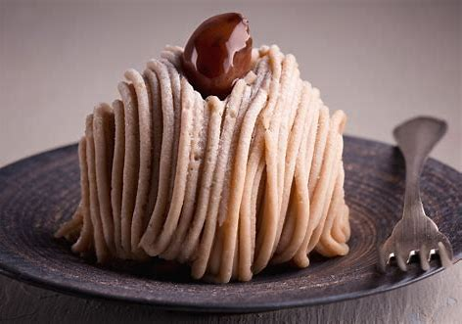
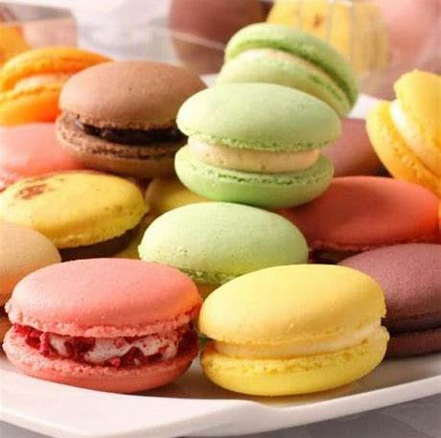
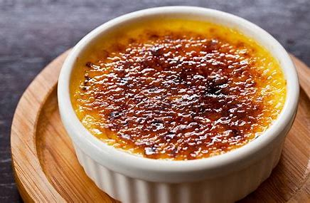
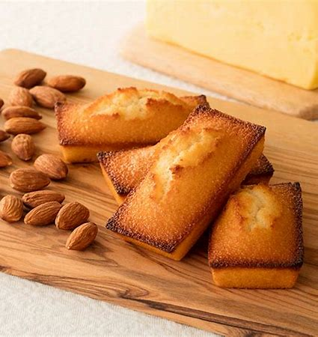
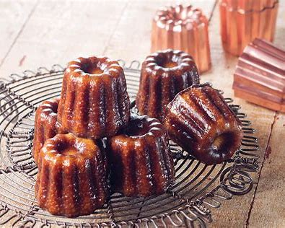
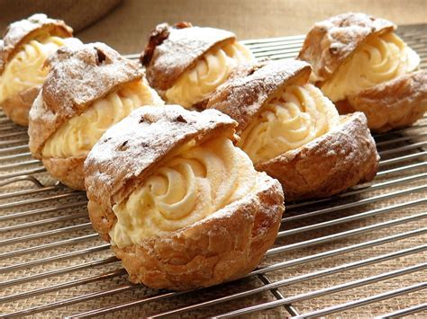
What kinds of sweets do you like?

Slide 11
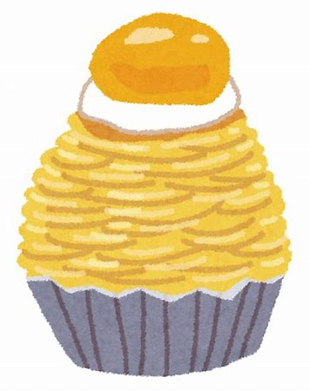
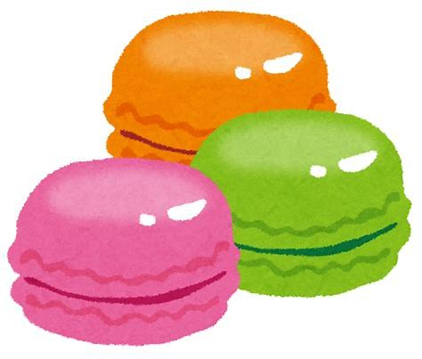
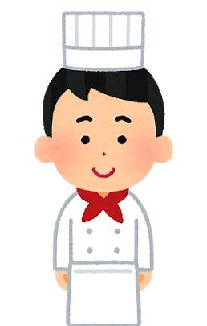
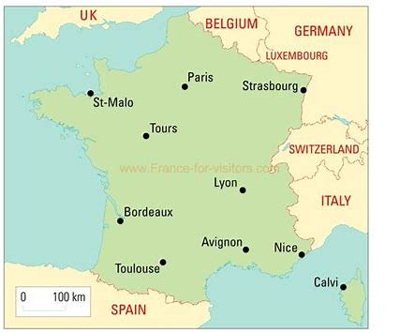
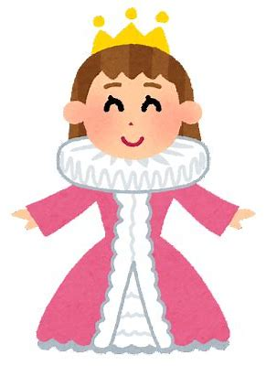
History of Sweets in France
・ Interchange with neighboring countries.
・The princess let a chef go together from their country.
・The sweets of the princess’s country were brought to France.
・The France’s sweets became famous all over the world.

Slide 12
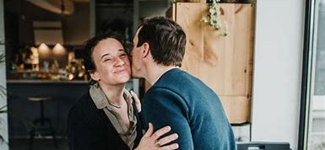
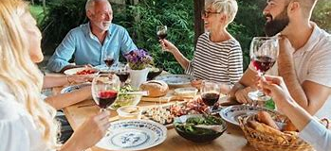
Etiquettes
Always start with a greeting.
Bonjour, Bonsoir.
Kissing on the cheek, Bise.
Don’t arrive early.
A little gift to the host.
Pouring wine or water into a glass is a role for men.

Slide 13
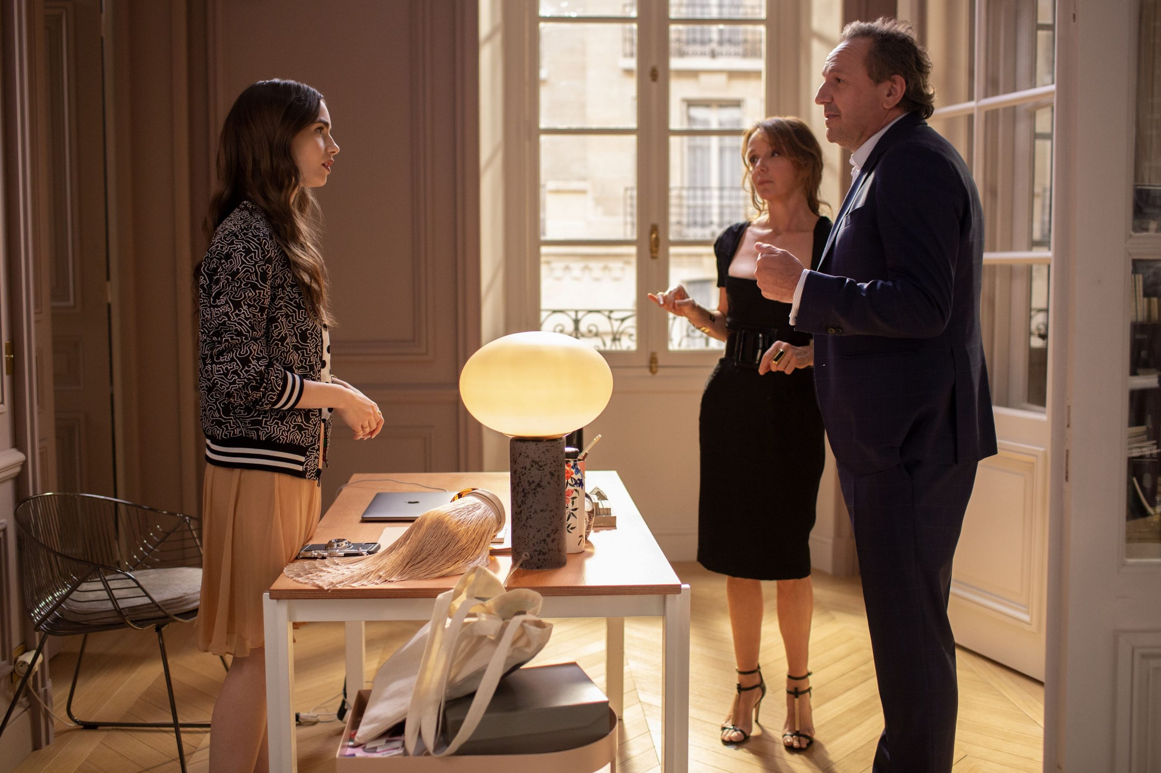
How to communicate in a workplace
To accept criticism and interruptions.
To listen to others until the end.
To say no in a situation that you can't afford.

Slide 14
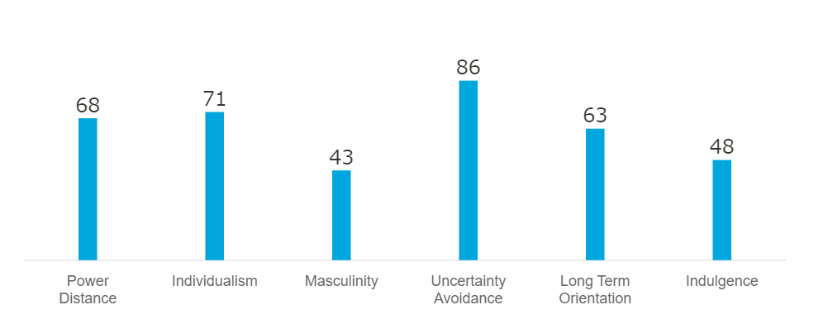
Cultural dimensions
Cultural dimensions

Slide 15
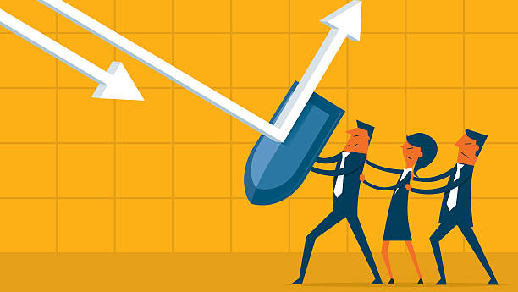
Uncertainty avoidance
French people don’t like surprise.
Structure and planning.
Pay attention to rules and regulations.

Slide 16
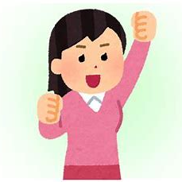
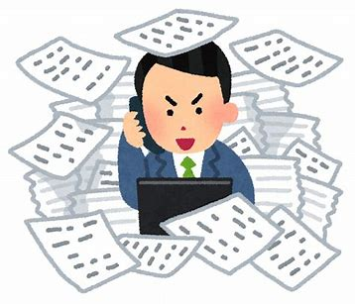
Individualism
People aim to get a better job position.
Competitions about jobs and trying to climb up in the hierarchy.
You are on your own.

Slide 17
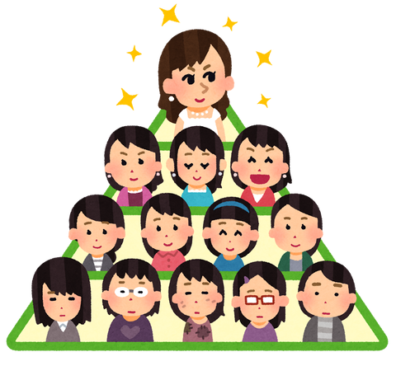
High power distance
There is a hierarchy.
People accept an inequality.
Higher class French people judge the person.
(how they dress up and their attitude)

Slide 18
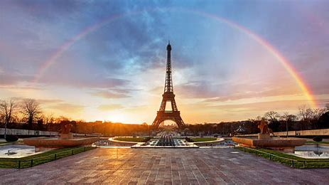
Thank you for listening

