Slide 1
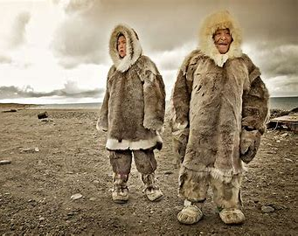
Inuit presentation
Koto, Keito

Slide 2
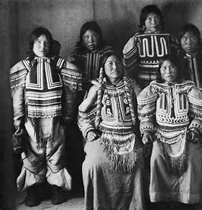
Brief Introduction
Actually, Inuit people are not considered first nations.
First nations are the people who had been living in North America before European came.
Inuit people came from other place, so they totally differ from other indeginous people.

Slide 3
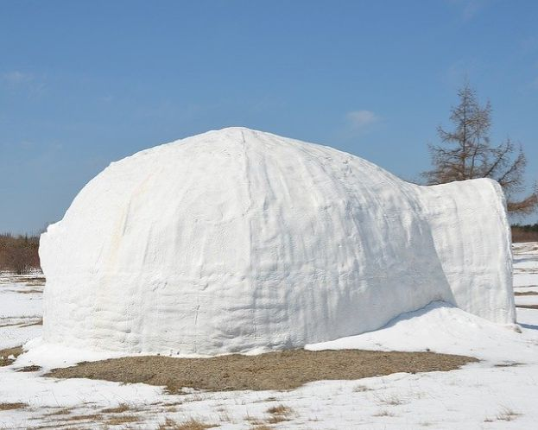
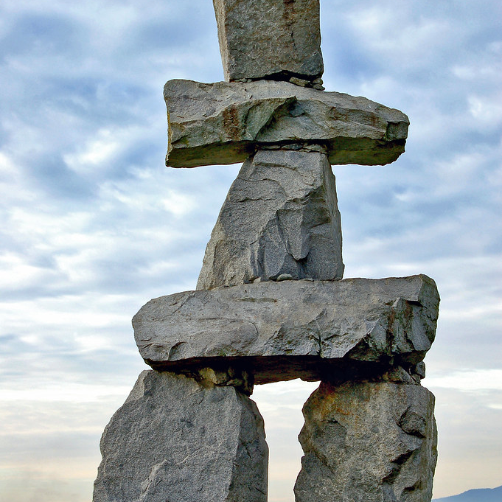
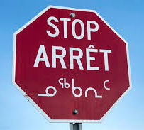

Tradition
Language
Atelihai,(Hello) iKalujatsiavait, (What a catch nice!)
House
Summer... tent Winter...Igloo
Inukshuk
In the snow, it's hard to find important places. Then, it is placed to indicate a food source.

Slide 4
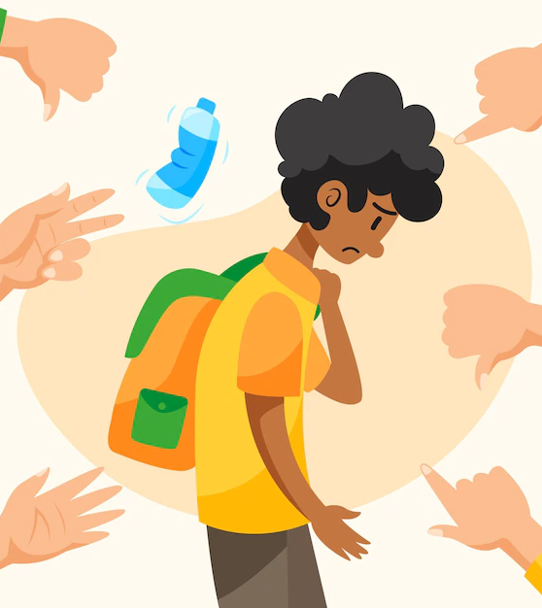
History
Eskimo – a racist word
‘savage who eat raw meat’
People changed how to call Inuit
Inuit – ‘people’ in Inuit language

Slide 5
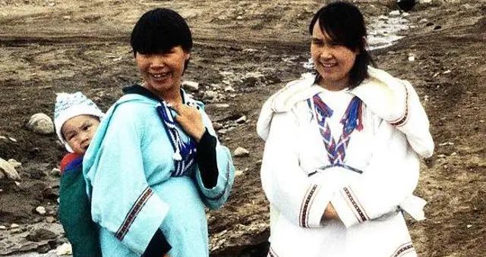
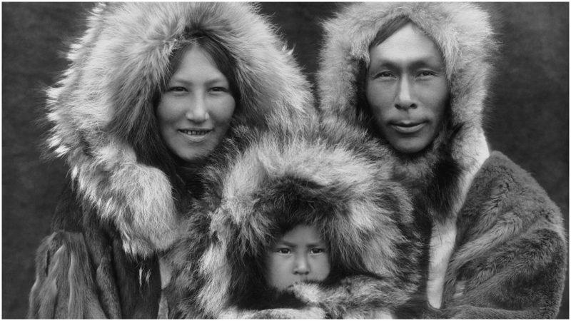
Why do they look Asian?
Inuit first came to America 15,000 years ago
They walked across a land bridge from Asia
Their origins are Asian
The total population of Inuit is approximately 64,235 in Canada

Slide 6
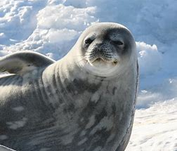
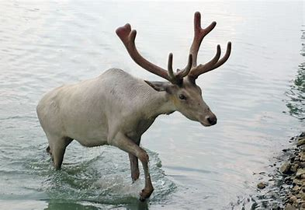
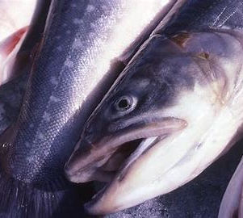
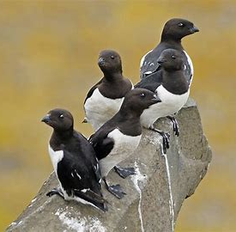
What kind of food do they eat?
Seals
Caribous
Fishes
Birds

Slide 7
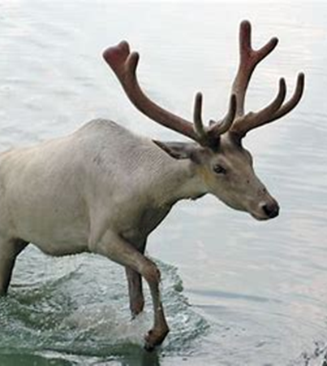
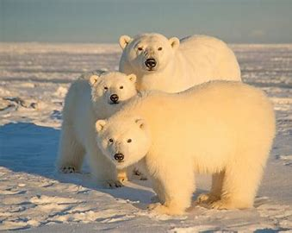
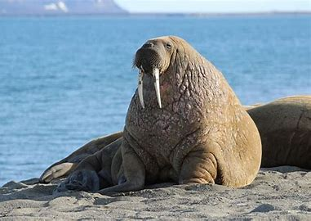
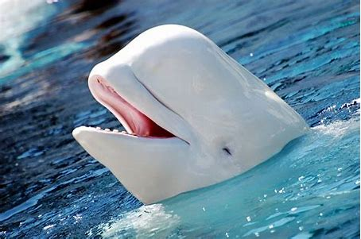
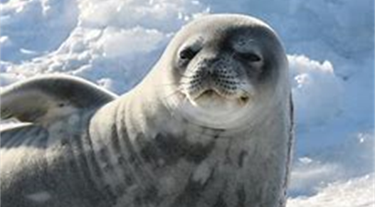
What they eat
To build up the energy by having a meat diet
Protein and high-caloric fat
They shared foods with family and friends

Slide 8
Changes of their lifestyle
The Canadian government moved Inuit into permanent settlements
Education
Health care
Social welfare services

Slide 9
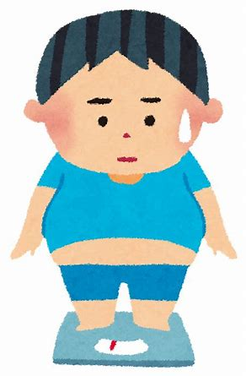
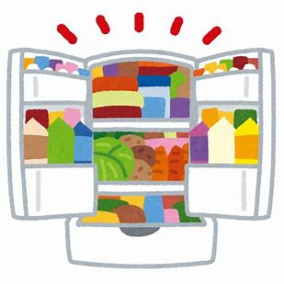

Food culture
Keeping foods in fridges for long time
Buying foods at a grocery store
They started to eat junk food
Health problems are concerned

Slide 10
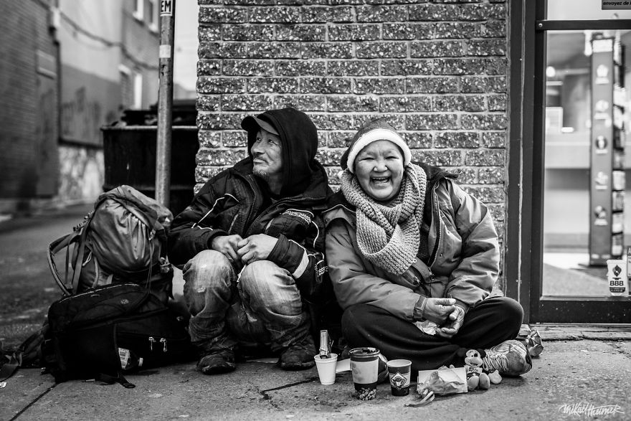
Current Problem
In a lot of places in Canada, many Inuit people are home-less. In Vancouver, over 2,000 people are living in a street or shelter.
Still now, many indigenous people have experienced discriminations.

Slide 11
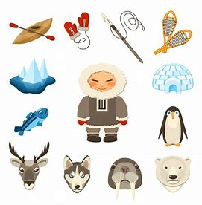
Conclusion
They are getting used to global environments
They preserve some part of their culture and take in new culture to live in the present

Slide 12
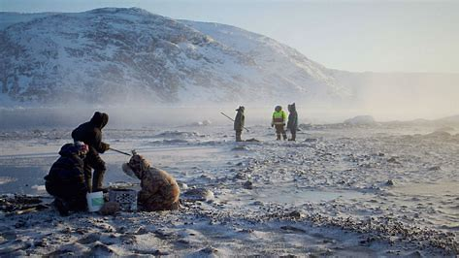
Thank you for listening!

